Slide 1



Multiplier-less FIR Filter Design
Multiplier-less FIR filter design is a powerful technique that reduces computational complexity and hardware requirements by eliminating costly multiplication operations. This approach is invaluable for resource-constrained and high-speed digital signal processing applications.
by Wai-Shing Luk

Slide 2
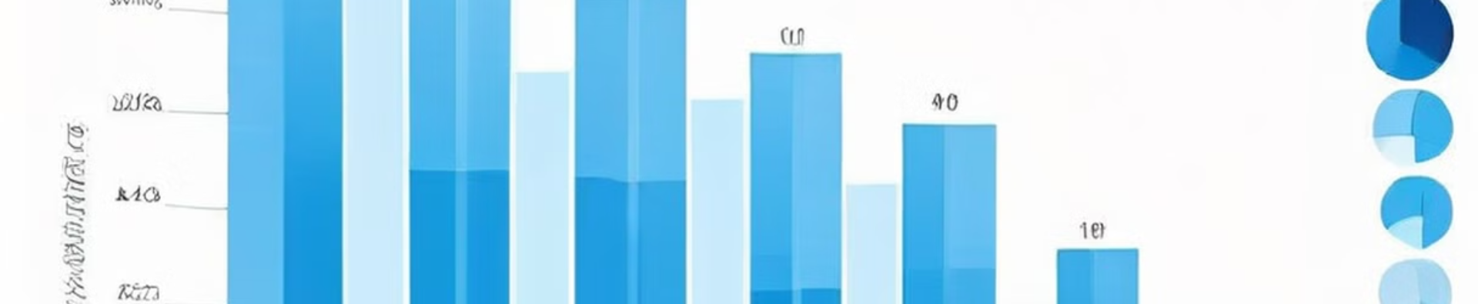
Coefficient Quantization
1
Quantize Coefficients
2
Replace Multiplications
3
Optimize Hardware
Coefficient quantization significantly reduces hardware complexity and power consumption.
FIR filter coefficients are quantized to powers of two or sums/differences of powers of two.
This allows replacing costly multiplications with simple shift and add operations.

Slide 3
Canonic Signed Digit (CSD) Representation
Sparse Representation
Fewer Additions
Efficient Hardware
CSD representation uses a minimal number of non-zero digits to encode filter coefficients.
The sparse representation reduces the number of additions required in the filter implementation.
CSD coefficients enable a more efficient hardware implementation of multiplier-less FIR filters.

Slide 4

Genetic Algorithms
Coefficient Optimization
Constrained Optimization
Genetic algorithms are used to optimize FIR filter coefficients while maintaining the desired frequency response.
The optimization can incorporate constraints on coefficient wordlength and adder cost for efficient hardware implementation.
Automated Design
Adaptable Approach
Genetic algorithms automate the design process, making it easier to explore the design space.
This technique is flexible and can be applied to a wide range of FIR filter design problems.

Slide 5

Linear Programming
1
Problem Formulation
The FIR filter design problem is formulated as a linear optimization problem.
2
Precise Control
Linear programming allows for precise control over various filter parameters, such as passband and stopband specifications.
3
Optimal Solution
The linear optimization process finds the optimal FIR filter coefficients that meet the design requirements.

Slide 6




Advantages of Multiplier-less FIR Filters
Hardware Efficiency
High-Speed Operation
Simplified Implementation
Reduced hardware complexity and power consumption.
Increased speed of operation compared to traditional FIR filters.
Easier to implement on FPGAs and ASICs.

Slide 7
Design Challenges
Filter Performance
Order vs. Precision
Design Complexity
Potential loss in filter performance due to coefficient quantization.
Trade-off between filter order and coefficient precision.
Increased design complexity compared to traditional FIR filters.

Slide 8

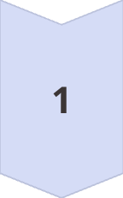
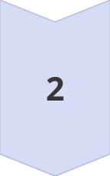
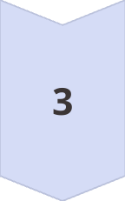
Applications
Software-Defined Radio
Multiplier-less FIR filters are essential for efficient signal processing in software-defined radio systems.
High-Speed Communications
They enable high-speed digital communication systems to operate at lower power and higher speeds.
Embedded Signal Processing
Multiplier-less FIR filters find widespread use in real-time signal processing for embedded systems.

Slide 9
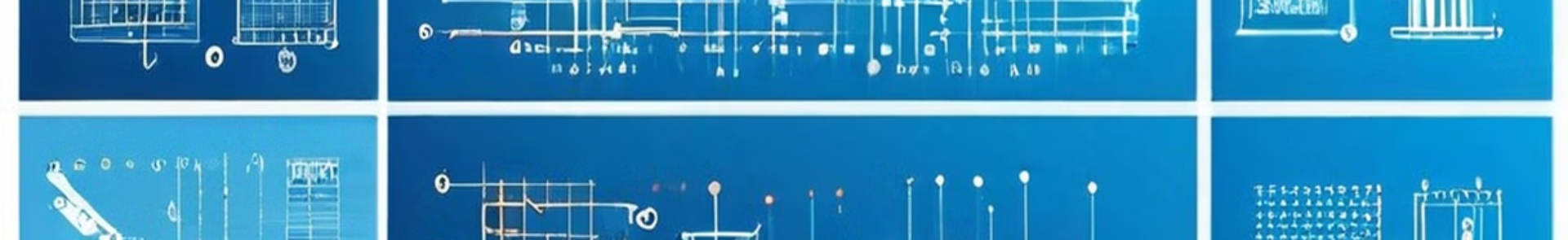
Design Techniques
Coefficient Quantization
1
Quantizing coefficients to powers of two or sums/differences of powers of two.
2
Canonic Signed Digit
Using the CSD representation to minimize the number of non-zero digits.
Genetic Algorithms
3
Optimizing filter coefficients while maintaining desired frequency response.
4
Linear Programming
Formulating the design problem as a linear optimization to precisely control filter parameters.

Slide 10

Conclusion
Multiplier-less FIR filter design is a powerful technique that significantly improves hardware efficiency and speed, making it an attractive choice for many digital signal processing applications. While it introduces some design challenges, the benefits of this approach make it a valuable tool in the digital filter designer's arsenal.

